Slide 1
USE CASE INTRODUCTION
To better understand your company's retention rate, I have used the dataset offered from your HR database comprising several employee attributes to make analysis and draw out conclusions. We would learn useful information about how to recognise, enhance, and reduce turnover among your employees.
We would understand the departments that has the most employee churn rate and look at the causes and provide solutions
We would predict employees who would leave next and give recommendations to stop that

Slide 2
SCOPE
Based on my own research and expertise, I have included the variables/attributes that, in this case study, I believe are the most crucial to the analysis. To do my analysis, I have determined the factors and the attributes listed below are to be considered:
Departments
Monthly Income
Performance Rating
Left (Dependant Variable)
Job Satisfaction
Excel was used in this analysis, a table was created and named HRdataset. Pivot tables and charts were created for this analysis.

Slide 3
Understanding ratings of Variables
The Performance rating is between 1 -5.
1 – Needs development
2 – Sometimes exceed expectations
3 – Often meets expectation
4 – Always exceed expectations
5 – Sets a new standard of Performance
The Job Satisfaction rating is between 1 – 4
1 – Unsatisfactory
2 – Satisfactory
3 – Very Satisfied
4. – Outstanding

Slide 4
ANALYSIS METHODOLOGY
An HR dataset was provided and this was used in the research study with datasets which included about 20 attributes. Various tables and charts were created using excel. Pivot table and pivot charts were created to identify high performing employees.
I created a trend line to see the trends common among people that have left
I created a several charts to show common trends among people that have been considered high performing but they have left
For the purpose of grouping, I created a table to show the employees who have left and those who still work for the company.

Slide 5
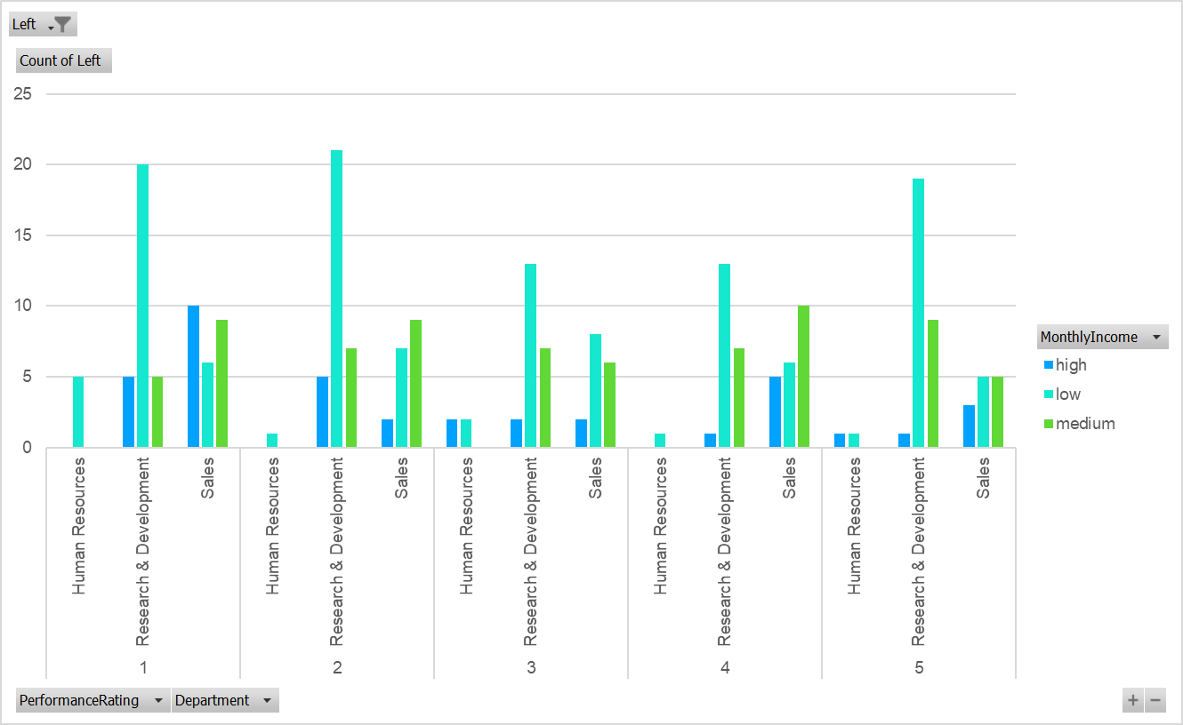
A chart of Performance Rating, Department, Monthly Income Versus Count of Left(Yes)

Slide 6
A chart of Performance Rating, Department, Monthly Income per Count of Left(Yes)
A Chart of the high performers, department and monthly income versus the count of employees that are still in the company is graphically represented in the chart above. It can be observed that the Research and development department has the highest number if low earners across board, they are the least paying employee and they are those that are the highest risk of leaving.

Slide 7
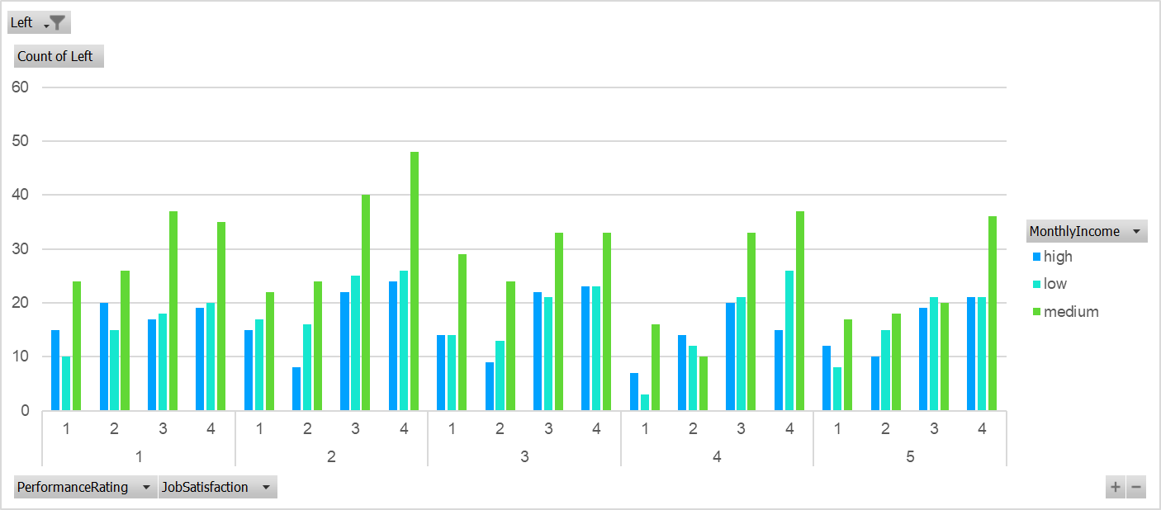
A Chart of Left against Performance Rating, Job Satisfaction and Monthly Income

Slide 8
Chart of employee performance rating, job satisfaction and monthly income
The chart above visualizes the count of employees who have left the organization against income, job satisfaction and performance rating and it was observed that:
A lot of the employees who are high performing and score between (3 -5, which is Satisfactory to Outstanding) love their jobs and are satisfied. High performers have medium income from the survey and it shows they have job satisfaction
Their income should be reviewed upwards if you want them to stay

Slide 9
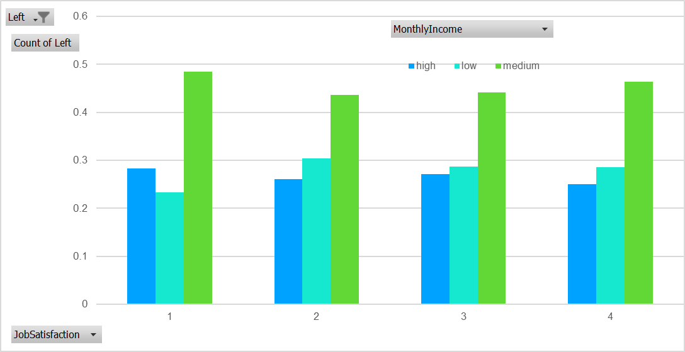
Chart of employees per job satisfaction and Monthly Income

Slide 10
Chart of employees per job satisfaction and Monthly Income
It can be observed in the chart above that most employees who are satisfied on their job with good rating from 3 – 5 have medium pay. This should be looked into.
I tried to create segments groups by creating relationships between job satisfaction, monthly income and performance rating per count of left but they were evenly distributed. I also used Percent salary hike, years at the company and total working years but there were no outliers.

Slide 11
RESEARCH FINDINGS
The column chart and table shows the visualization of the performance rating for those that have left the company against their departments. It can be observed that more people from the Research and development have the highest employee churn rate.
More visuals was carried out to understand why. Monthly income, Department, Performance Rating and count of employees who have left was analysed. It was observed that most high performing employee earned a low income in the Research and Business department.
Similarly a chart was created to show the performance rating of employees that are still in the company against their department and monthly income. It can be observed that 66% of the employees who are high performing (from Satisfactory to Outstanding) in the Research and development department are low and medium income earners as well and. It predicted that they will be the next set of employees to leave.
All of these are represented in the table and charts below

Slide 12
The pivot table shows a summary of monthly income against performance rating
Count of employee against monthly income and performance rating
Count of employees that have left and those that are still at the company
Column Labels
high | low | medium | Grand Total
25% | 52% | 23% | 100%
13% | 56% | 31% | 100%
14% | 55% | 31% | 100%
14% | 47% | 40% | 100%
11% | 57% | 32% | 100%
16% | 53% | 31% | 100%
Count of Left | Column Labels
Row Labels | No | Yes | Grand Total
1 | 256 | 60 | 316
2 | 287 | 52 | 339
3 | 258 | 42 | 300
4 | 214 | 43 | 257
5 | 218 | 44 | 262
Grand Total | 1233 | 241 | 1474

Slide 13
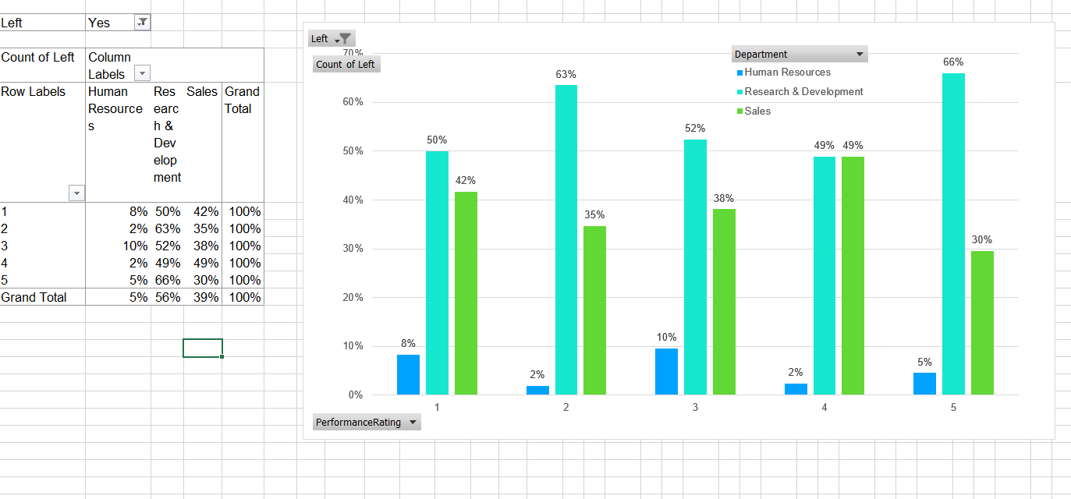
Count of Left (YES) against Performance Rating and Department.

Slide 14
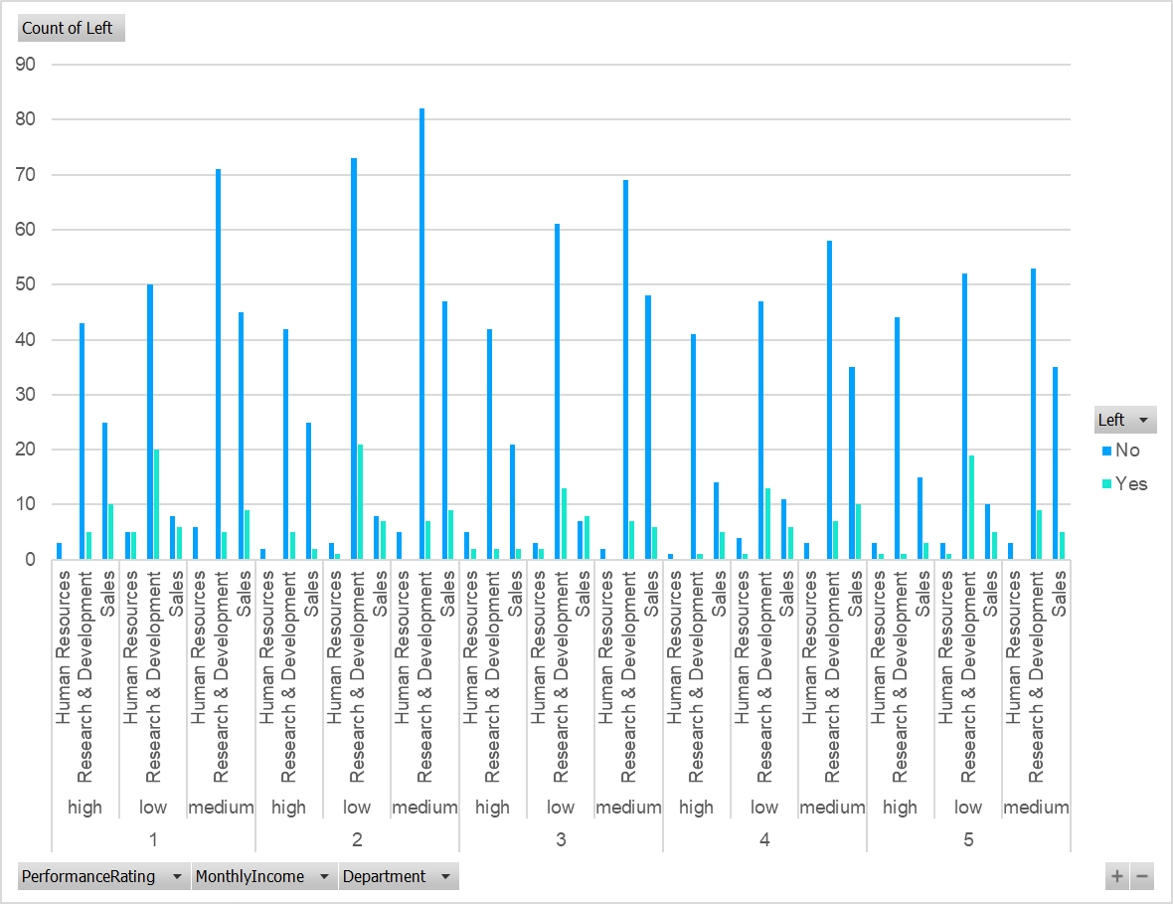
A comparison of left against PR, Monthly income and Department
The chart below shows the comparison between both employees that work for the company and those that have left.

Slide 15
RECOMMENDATIONS
After thorough analysis of the given dataset, I would recommend the following;
High performing employees can be retained when their salary or income is increased.
From the analysis and visualization, it is predicted that employees in the Research and development team will be the next to leave because they are the high performing staff but with medium to low pay.
Employees in the Research and Development team who still work in the company are poorly paid.
You can increase salary across board and especially in the business and development team.
Employees who are satisfied on their job and high performers are medium income earners and I recommend that their income is reviewed upwards.

